Slide 1
Texture

Slide 2
Texture Mapping
Map the texture onto 3D mesh.
Texture mapping demonstration animation.gif – Drummyfish – CC0 1.0 Universal (CC0 1.0) Public Domain Dedication
https://commons.wikimedia.org/wiki/File:Texture_mapping_demonstration_animation.gif

Slide 3
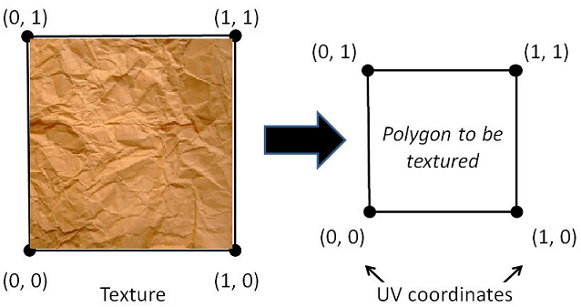
Texture Coordinates
Range from 0 to 1 in the x and y axis
To retrieve the texture color (sampling)
http://www.c-jump.com/bcc/common/Talk3/OpenGL/Wk07_texture/Wk07_texture.html

Slide 4
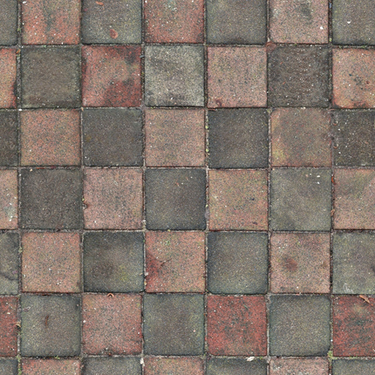
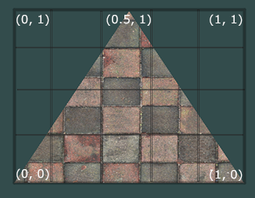
Texture Coordinates
Specify texture coordinate points for the 3d model
Pass the texture coordinates to the vertex shader & fragment shader
Interpolate all the texture coordinates for each fragment
https://learnopengl.com/Getting-started/Textures

Slide 5
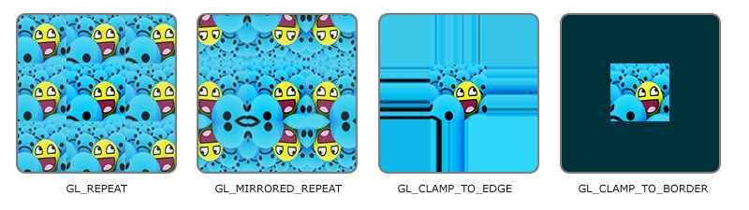
Texture Wrapping
https://learnopengl.com/Getting-started/Textures

Slide 6
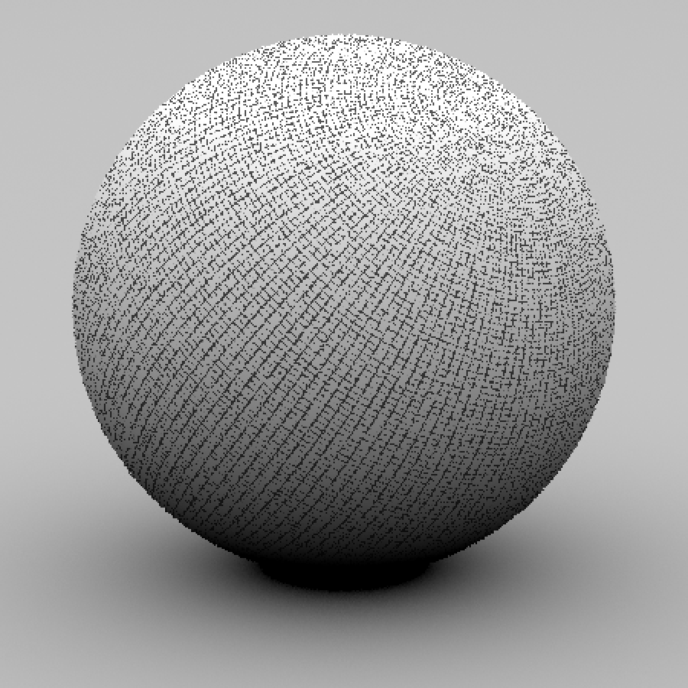
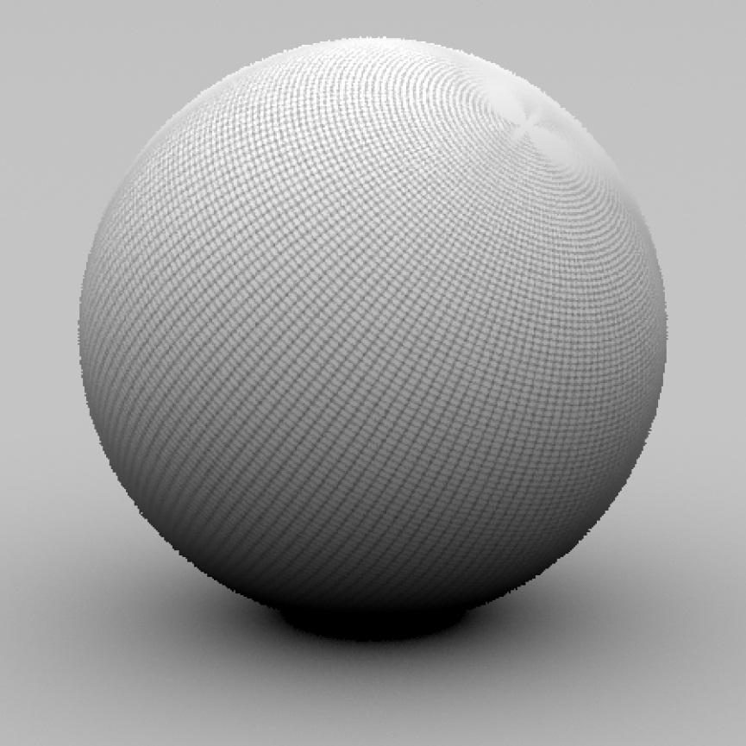
Texture Filtering
Determine which texture pixel (also known as a texel) to map the texture coordinate to.

Slide 7



Texture Filtering
https://learnopengl.com/Getting-started/Textures

Slide 8
Texture Filtering
Texture
Polygon
Texture
Polygon
Magnification
Minification

Slide 9
Texture Filtering
glTexParameteri(GL_TEXTURE_2D, GL_TEXTURE_MIN_FILTER, GL_NEAREST);
glTexParameteri(GL_TEXTURE_2D, GL_TEXTURE_MAG_FILTER, GL_LINEAR);

Slide 10
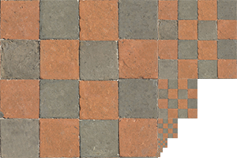
Mipmaps
Small objects with the high solution texture
=> visible artifacts & waste of memory
Each subsequent texture is twice as small compared to the previous one
Less cache memory
https://learnopengl.com/Getting-started/Textures

Slide 11
Mipmaps
GL_NEAREST_MIPMAP_NEAREST
GL_LINEAR_MIPMAP_NEAREST
GL_NEAREST_MIPMAP_LINEAR
GL_LINEAR_MIPMAP_LINEAR
https://learnopengl.com/Getting-started/Textures

Slide 12
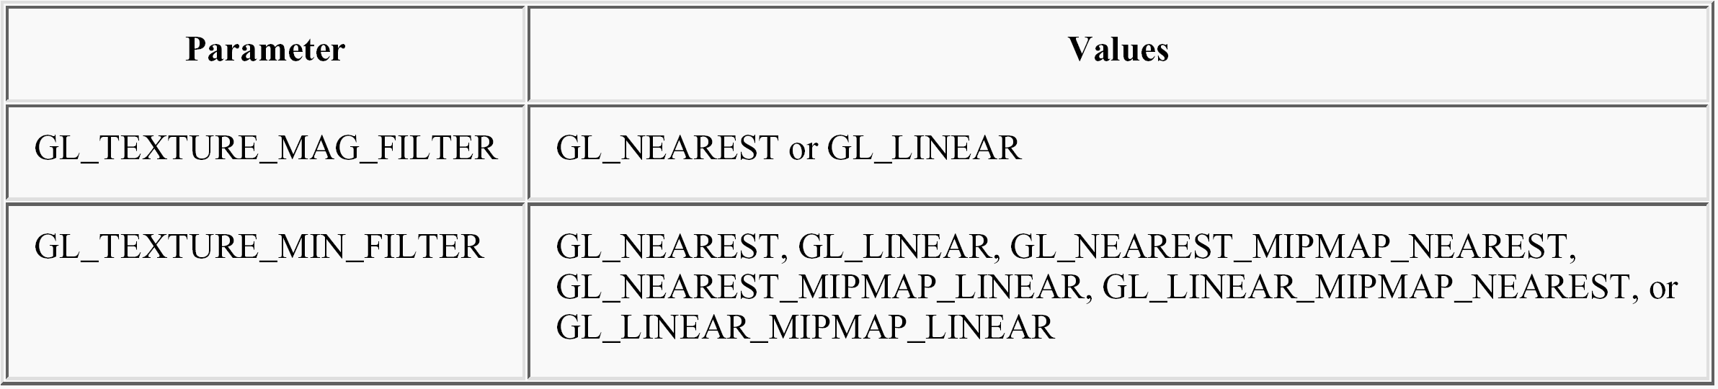
Mipmaps
glTexParameteri(GL_TEXTURE_2D, GL_TEXTURE_MIN_FILTER, GL_LINEAR_MIPMAP_LINEAR);
glTexParameteri(GL_TEXTURE_2D, GL_TEXTURE_MAG_FILTER, GL_LINEAR);

Slide 13
Generating & Applying Textures

Slide 14
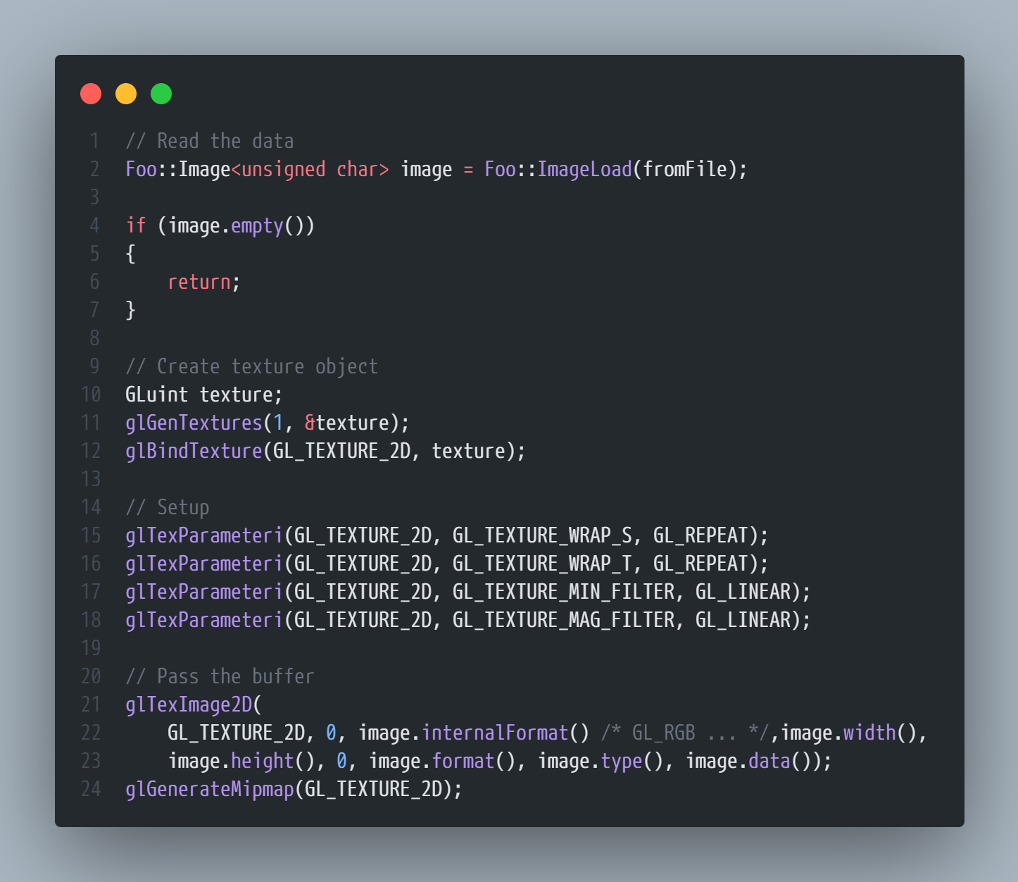
Generating Textures
Read the image from file input stream.
Generate the texture object.
Bind and setup the texture object.

Slide 15
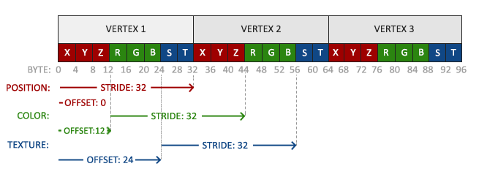

Applying Textures
https://learnopengl.com/Getting-started/Textures

Slide 16
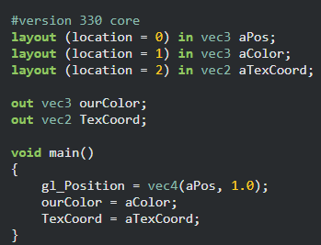
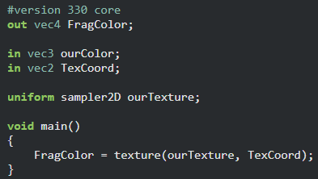
Applying Textures
Vertex Shader
Fragment Shader
https://learnopengl.com/Getting-started/Textures

Slide 17
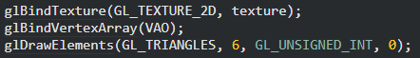
Applying Textures
https://learnopengl.com/Getting-started/Textures

Slide 18
Reference
https://learnopengl.com/Getting-started/Textures

